Slide 1
An Expert in Mobile and Web Solutions
Payment Gateway for
Shopify, Magento and word press
System Development Cost Proposal
We are system integration and software development company that provide ICT solution based on what our customer needs. We develop and customise enterprise software applications to resolve your operation issue, deliver the reliable system on time and implement the best value IT solution for our customers. Our project consultants and software engineers have more than 7 years of experiences in enterprise and mobile app implementation for SME and corporate customers.

Slide 2
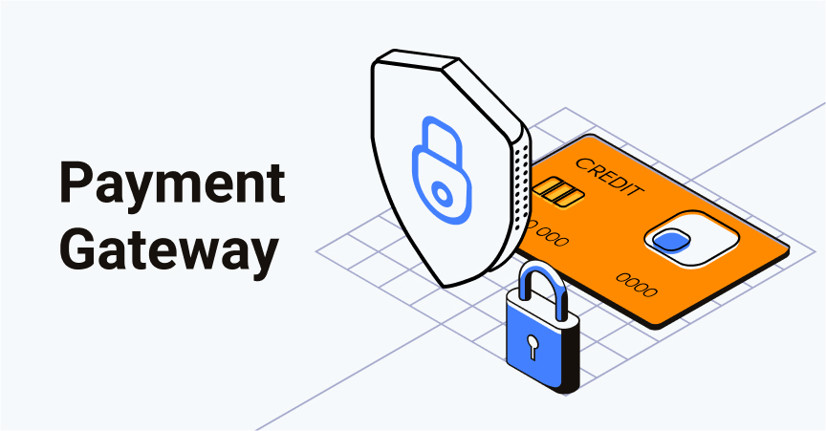
The Big Idea
The objective of the project is to develop a online payment gateway plugin for Shopify, Magento and WordPress.
This plugin will facilitate the e-commerce merchants to quickly integrate payment gateway plugin for Shopify, Magento and WordPress.
This Payment Gateway Service that enables you to accept payments online from your customers via Visa, MasterCard and Internet Banking services.

Slide 3
Deliverables
The following are the deliverables:
Payment plugin for WordPress
Payment plugin for Shopify
Payment plugin for Magento

Slide 4
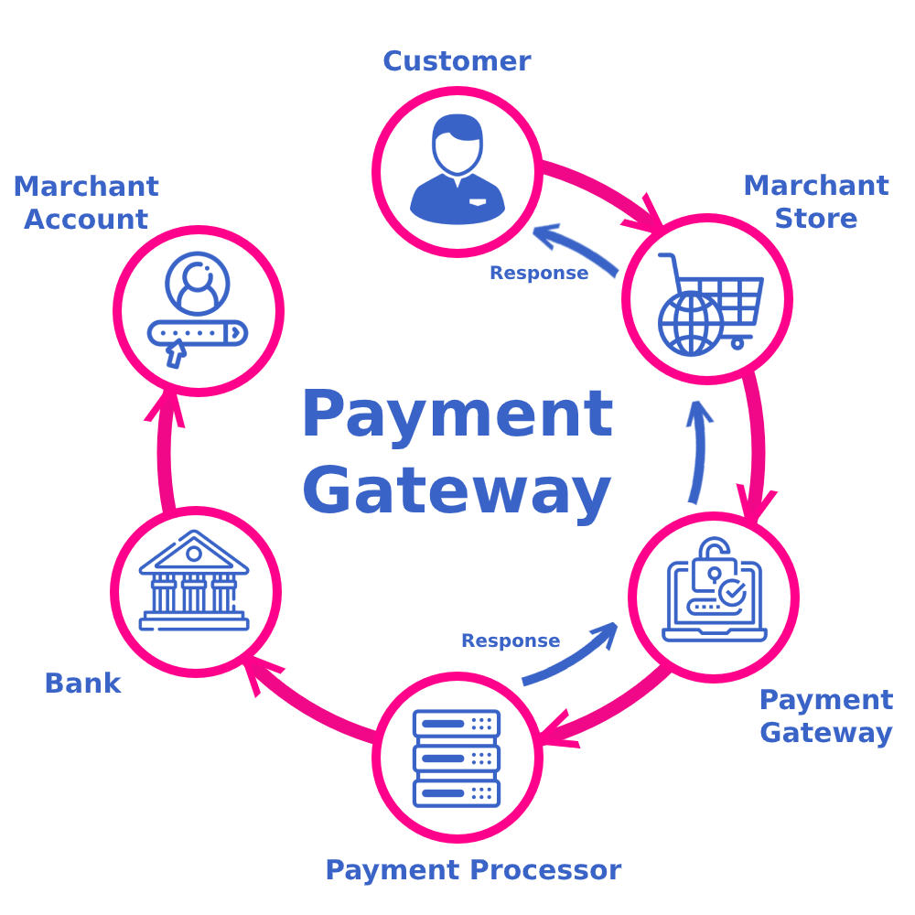
How Payment Gateway Works

Slide 5
Work Breakdown Structure
Requirement Gathering and Documentation
Admin Page
Settings
Merchant authentication credentials
Enable / Disable Bank transfer
Title
Display Logo
Description
Test Mode
Payment Option
Live Secret Key
Initial Order Status
Expiry Date
Mail Payment Instructions
Merchant ID
Onsite Checkout
Order Status
Payment report page
Saved Cards
Customer Page
Check-out Page
Contact Information
E-mail ID
Shipping Address
First Name
Last Name
Address
Delivery Method
Standard Delivery
Express Delivery
Review and Place Order
Payment
List of Payment Methods
Visa
MasterCard
Internet Banking services
Check-out Details
Transaction History
Testing & UAT
Build Release
Go Live

Slide 6
Timeframe
Requirement Gathering, Analysis & Documentation
Weeks
01-02
Design and Development Completion
Weeks
03-16
UAT Release, Sign off & Deployment
Weeks
17-18
Note:
The given project delivery plan is based on our regular resource planning. In case of any deadline we can tweak the plan based on mutual consent.

Slide 7
Technology Stack
Description | Technology
Backend Programing language | PHP
Framework | WordPress, Shopify and Magento
Database | MariaDB
Frontend | HTML5, CSS3, JavaScript, JQuery

Slide 8
Cost
Item | Job Description | Amount (USD)
1 | WordPress Payment gateway plugin | 8000
2 | Magento Payment Gateway Plugin | 8000
3 | Shopify Payment Gateway Plugin | 8000
 | TOTAL | 24,000

Slide 9
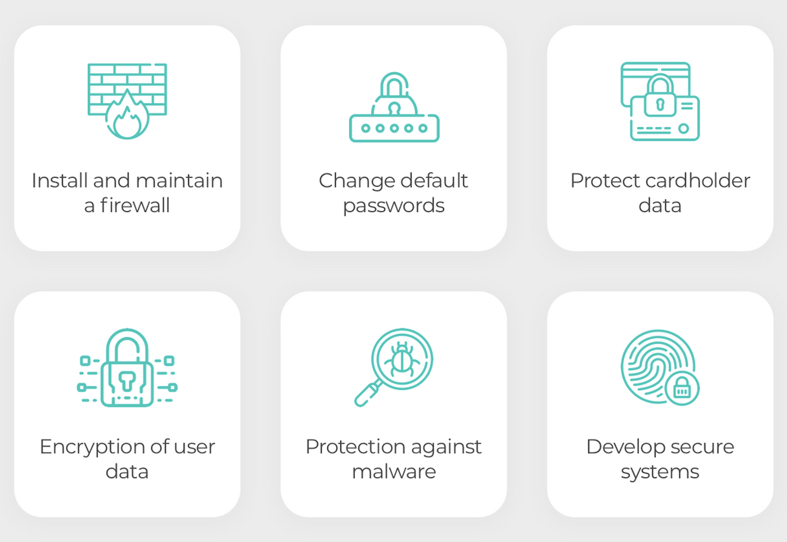
PCI DSS Compliance (Optional)
The PCI DSS (Payment Card Industry Data Security Standard) is a security standard developed and maintained by the PCI Council.
The purpose of PCI DSS compliance is to help secure and protect the entire payment card ecosystem. This is mandatory compliance if we are storing credit card information.

Slide 10
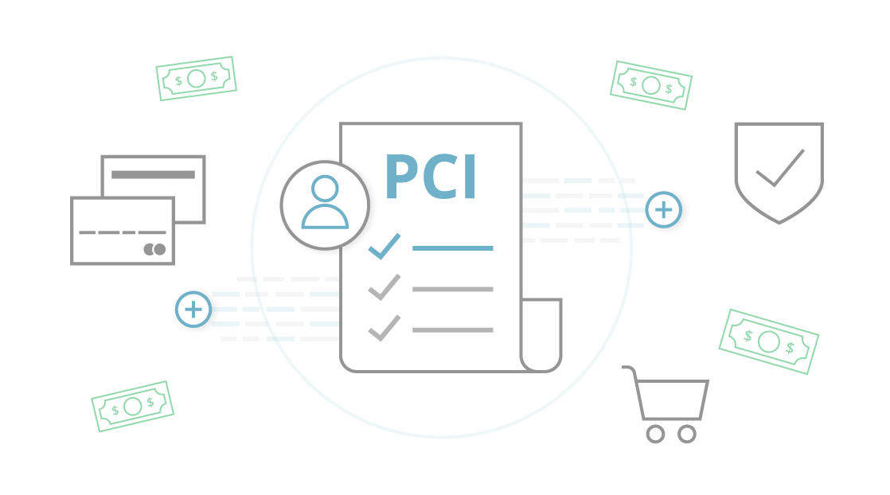
PCI DSS Compliance (Optional)
The following are the implementation requirements of the PCI DSS:
Implement & protect your system with firewalls
Configure passwords and settings
Protect stored user data (credit cardholder data)
Encrypt transmission of user data across open, public networks
Use and regularly update anti-virus software
Regularly update and patch systems
Restrict access to user data to business need to know
Assign a unique ID to each person with computer access
Restrict physical access to workplace and cardholder data
Implement logging and log management
Conduct vulnerability scans and penetration tests
Documentation and risk assessments

Slide 11
Assumption
The estimate covers the efforts for developing functionalities mentioned in Work Breakdown Structure section.
The estimates are based on requirement shared by the client.
We assumes that the stakeholders will be available for clarifications and support throughout the project time frame
All contents will be provided client.
Source codes will release to client upon full payment made
Web hosting for production and beta testing will be provided by client

Slide 12
